Slide 1
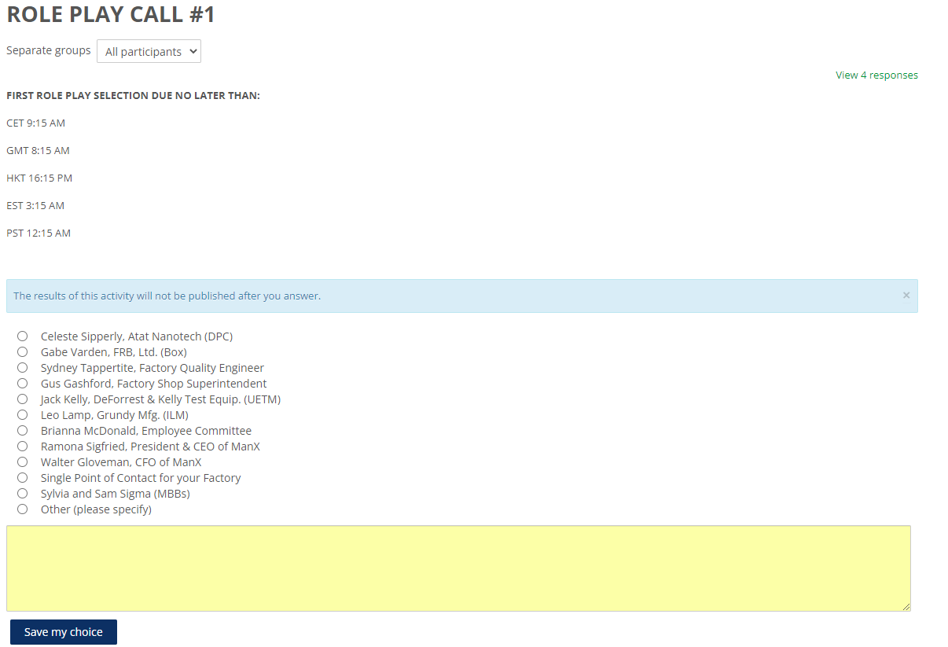
Make a group activity where only one response
Is permitted
Add Title Notes

Slide 2
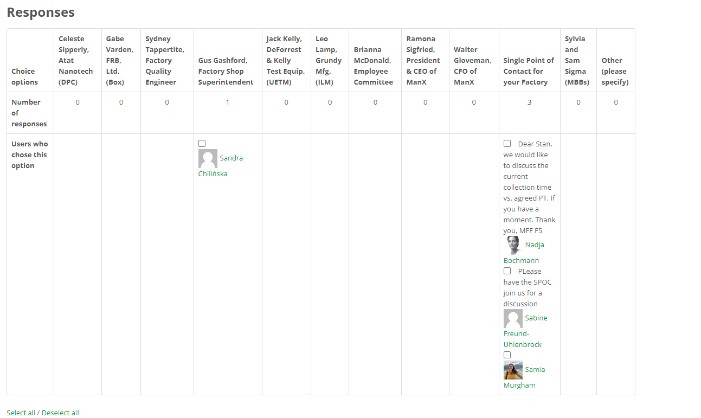
Group along the top axis
User indicated as shown
Character along the side Axis
Add an icon to show if there are notes.
Click on the icon to see the notes in a window

